Slide 1
Study Buddy
Presentation #5
Coding
Testing
Progress

Slide 2
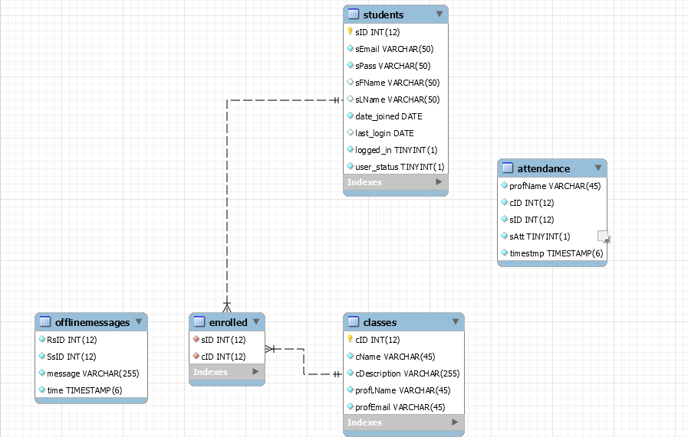
Database
MySQL, ksh
4 Tables Loaded
Students
Classes
Enrolled
Script that uses
a properties file
to read and
execute files.
Issues reloading
after drop

Slide 3
DB - Commands
INSERT INTO students(sID, sEmail, sPass, sFName, sLName, date_joined, last_login, logged_in, user_status) VALUES ( 1, 'tray@uncg.edu', 'pass1', 'Tray', 'McKnight', '2017-03-22', '2017-03-22', 1, 0);
INSERT INTO classes ( cID , cName, cDescription, profLName, profEmail) VALUES (001, 'CSC 553' , 'Theory of Computation' , 'Blanchet-Sadri', 'fsadri@uncg.edu');
INSERT INTO ENROLLED (sID, cID) VALUES ( 1,0);

Slide 4
GUIs
GUIs have been coded in Java and XML
Currently have 10 GUIs
All of the GUIs have a similar format

Slide 5
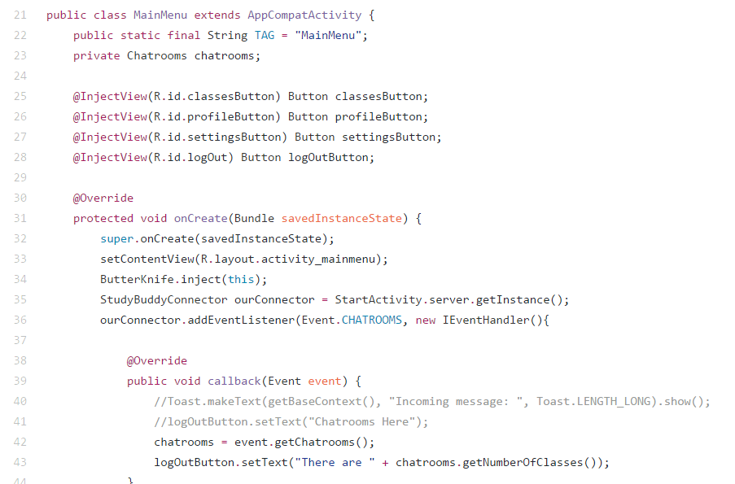
GUIs - Java

Slide 6
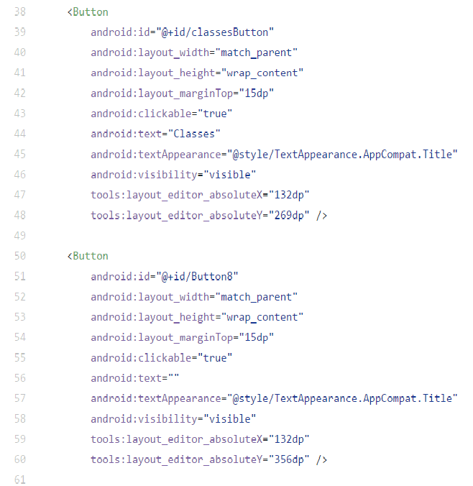
GUI - XML

Slide 7
Server
Written in Java
These are separate classes that allow GUI and server communication
Can be instantiated by the GUIs to use its methods

Slide 8
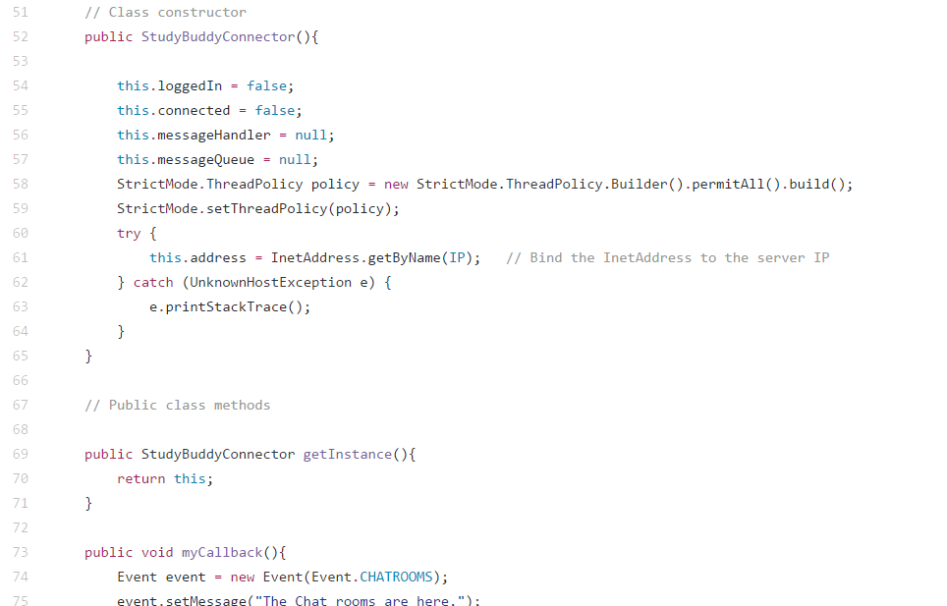
Server

Slide 9
Remaining Tasks
Image Transfer
Encryption
Write Script
Case Queries
Finish up Website
Additional GUI features
Owner’s Manual/Documentation

Slide 10
Testing Plans
GUIs - Manual and JUnit
Server - Manual and JUnit
Database - Manual

